Slide 1
EFFECTS OF SMARTPHONES ON TEENAGERS
Gözde DİNÇ

Slide 2
Outline
Introduction
Effects on social relationship
Effects on education
Sexting
Conclusion

Slide 3
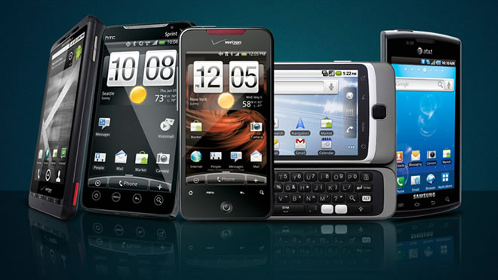
Smartphones
www.buzz2fone.com

Slide 4
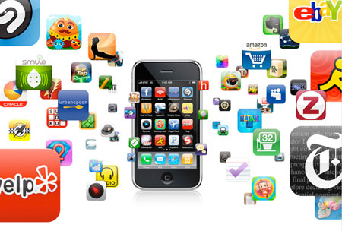
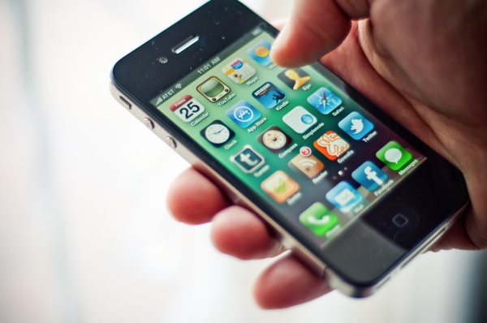
Smartphones
www. ten-mobile.com

Slide 5


Effects on Social Relationships
www.123rf.com
www.theage.com.au

Slide 6
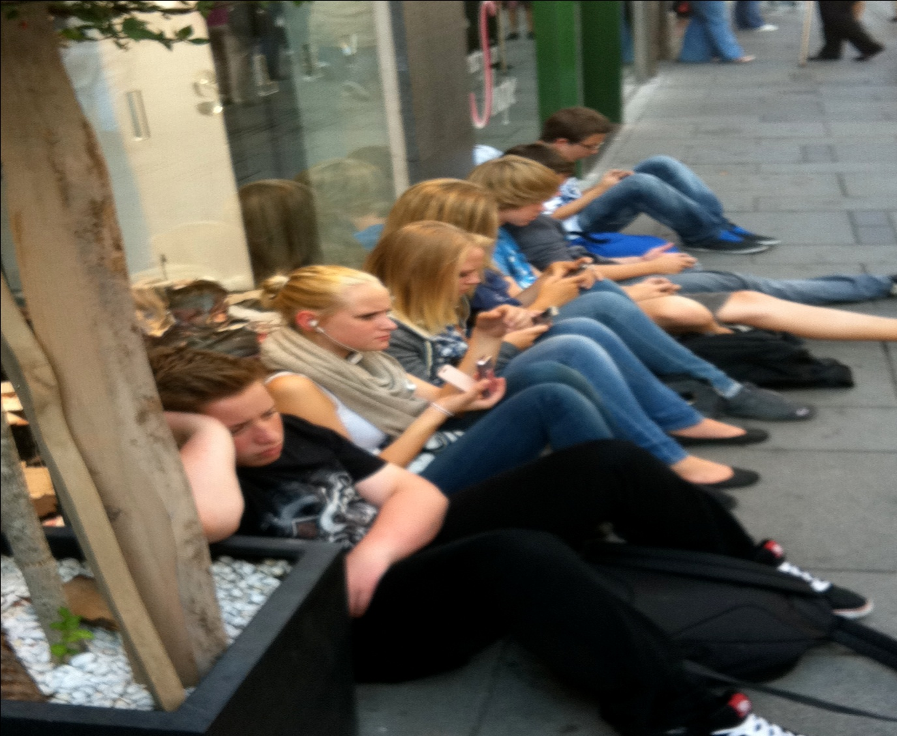
Effects on Social Relationships
archive.mises.org

Slide 7
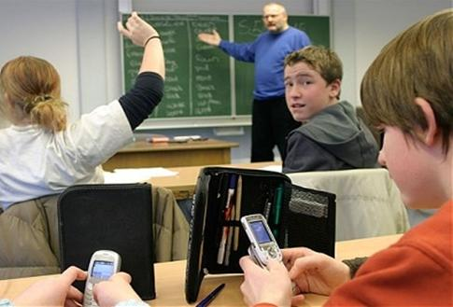
Effects on Education
www.ptclworkers.com

Slide 8
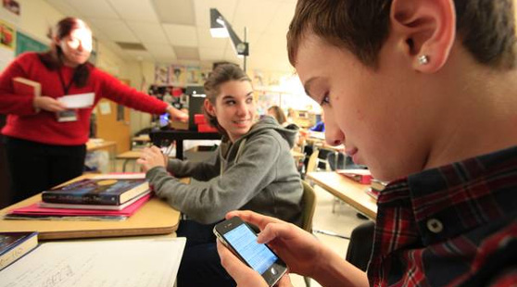
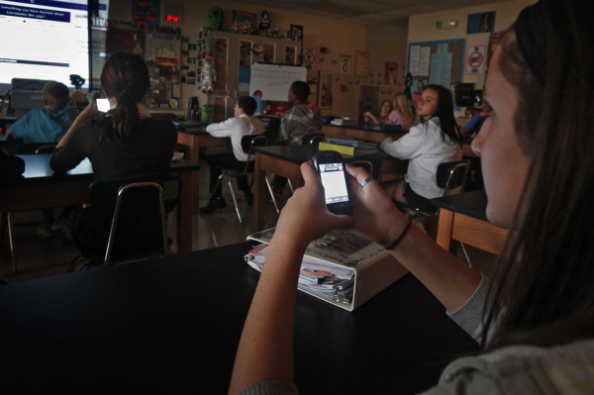
Effects on Education Inattentivaness
physicsoflearning.com

Slide 9
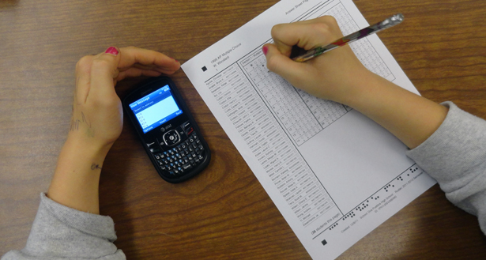

Cheating
www.whatteachersaid.com
www.digdang.com

Slide 10

Sexting
info.uknowkids.com

Slide 11


Sexting
www.parentdish.co.uk

Slide 12

To conclude..
venturebeat.com

Slide 13
References
Common Sense Media. (2010). Do Smart Phones = Smart Kids? Available from commonsense media.
Greenfield, S. ‘‘Attention Deficit Hyperactivity Disorder (ADHD): The Efficacy of Ritalin.’’ House of Lords (Committee Room
4A). 16 November 2009.
Lenhart, A. (2012). Teens, Smartphones & Texting (Project). Available from PewResearchCenter.
. Research. Sexual Addiction & Compulsivity, 17, 241-246.
Weiss, R. & Samenow, P. C. (2010). Smart Phones, Social Networking, Sexting and Problematic Sexual Behaviors- A call for
www.buzz2fone.com
physicsoflearning.com
www. ten-mobile.com
www.123rf.com
venturebeat.com
www.theage.com.au
archive.mises.org
www.ptclworkers.com

Slide 14


